Slide 1
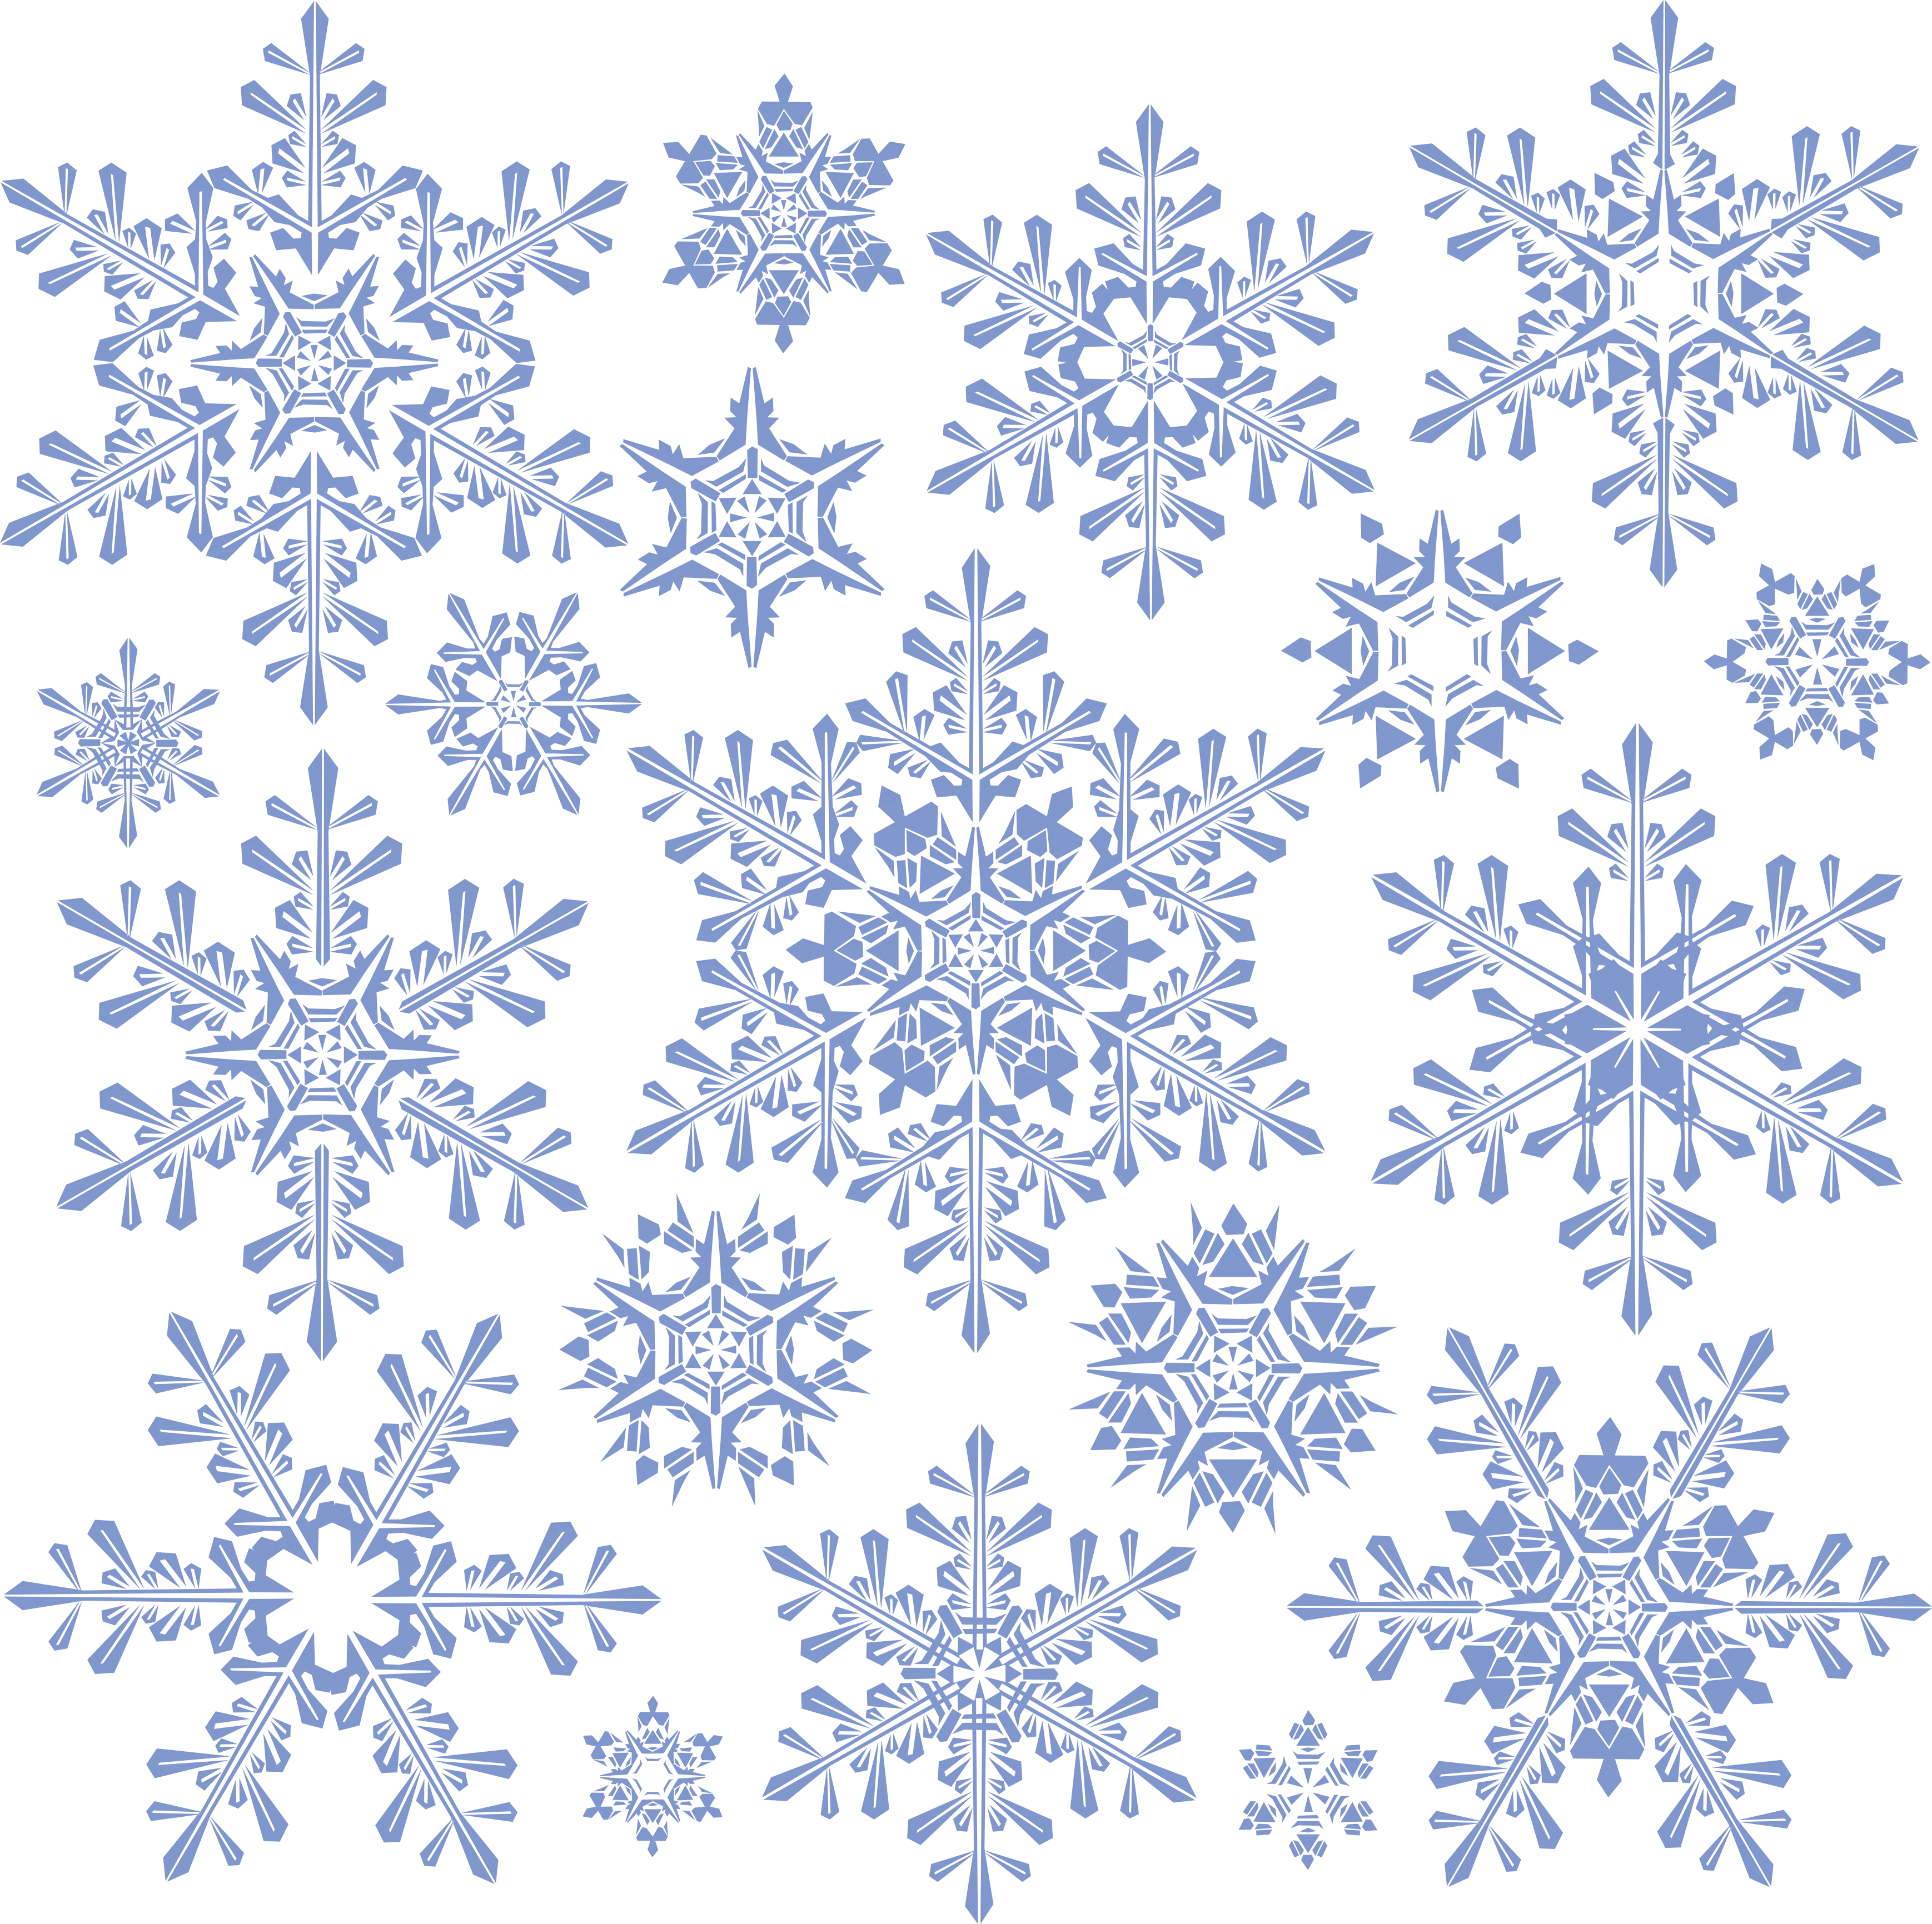
Maliseet Nation
Conservation Council
Dedicated to the conservation & co-management
Of our Traditional Resources in the St John Watershed/ Bay of Fundy
Visit our Website: www.maliseetnationconservation.ca and Like us on Facebook
A Quarterly Newsletter Winter(Puniw)2023
MNCC2023
Open House
Science Director
Dr Aruna Jayawardane
Invasive Species
CFOLC, MNCC
By Roger Sark
Winter Update, 2023
Winter
coloring page
Page1 Page2 Page3 Page4
MNCC 11th Annual Christmas
OPEN HOUSE
December 18, 2023
11am-2pm.
EVERYONE IS WELCOME
Refreshment!!
Prizes drawn every hour
1st Prize @12pm----Air Pod Pro
2nd Prize @ 1pm----Chrome Book
3rd Prize @ 2pm----65” Screen TV
Page 1

Slide 2
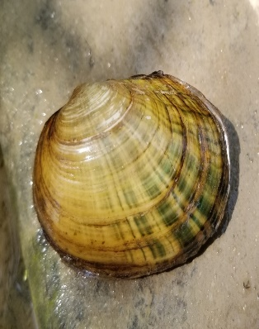
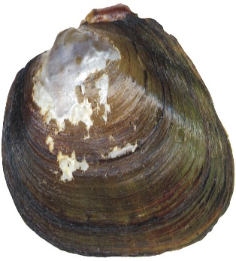
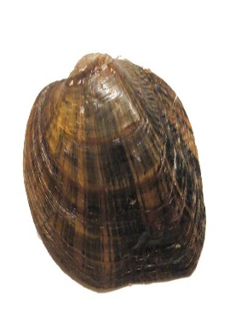
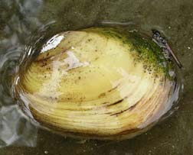
Study of the ecology and distribution of mussels in the Wolastoq
By Dr Aruna Jayawardane
Freshwater mussels are the most imperiled group of organisms in North America with ~75% of species considered endangered, threatened, or at risk. According to SARA, New Brunswick has one species that is extirpated (Dwarf Wedgemussel; Alasmidonta heterodon), two species of special concern (Yellow Lampmussel [Lampsilis cariosa] and Brook Floater [Alasmidonta varicosa]), one species considered sensitive (Triangle Floater; Alasmidonta undulata), and two species with insufficient data to assess their status within New Brunswick (Tidewater Mucket [Leptodea ochracea] and Creeper [Strophitus undulatus]).
In 2024, MNCC will conduct a study in collaboration with the Biology Department of UNB to understand the distribution and ecology of the Yellow lampmussel (YLM) but the study will undoubtedly provide data on other endemic freshwater mussel species based on the novel approaches we propose for mussel detection and monitoring. This study is the extension of the investigation conducted in the summer of 2023 to evaluate the ecology of mussels in the Wolastoq. During the proposed assessment, we are planning to conduct a survey of host fishes of YLM and to assess the timing of glochidia release in the vicinity of YLM populations that we identified in the Salmon and Canaan Rivers. We will use small-mesh fyke nets for the collection of small-bodied fishes and plankton nets for the collection of glochidia, respectively. In 2023, we successfully collected white perch, yellow perch, pumpkinseed, and redbreast sunfish and found that white perch and yellow perch are documented hosts for YLM, but many other endemic fishes have never been assessed regarding permittivity.
Historically, freshwater mussel assessment and monitoring programs have employed morphological characteristics restricted to the mussel's adult life stage. This often requires lethal sampling and the personnel qualified to carry out species-level diagnostic surveys that are restricted to taxonomists with many years of experience. Moreover, our recent data from the Wolastoq revealed that some species are morphologically indistinguishable even as adults. Misidentifications of freshwater mussels can over- or under-estimate population sizes. The novel approach that we will use during the study to identify mussels using DNA sequencing will be instrumental in enhancing the conservation and management of the mussel populations in the river. During the proposed investigation, we are planning to catch known host fish of YLM and separate glochidia larvae from their gills. Initially, we will morphologically identify the larvae and then they will be identified based on the mitochondrial DNA sequencing. We are planning to identify new populations of YLM and other mussel species in the river and their fish hosts during the proposed study. In addition, the timing of glochidia release by known host fishes will also be investigated during the study.
Lampmussel
Wedge mussel
Brook floater
Yellow Mussel
Page 2

Slide 3
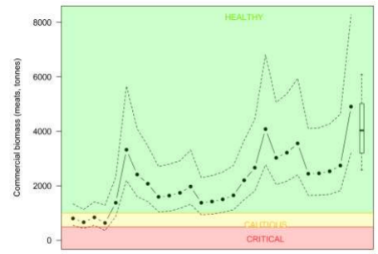
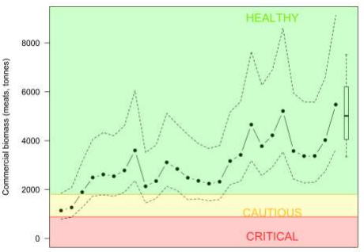
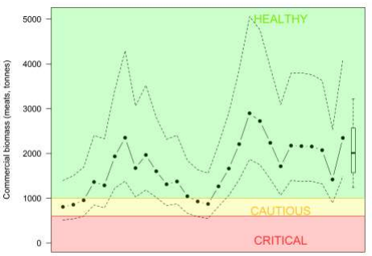
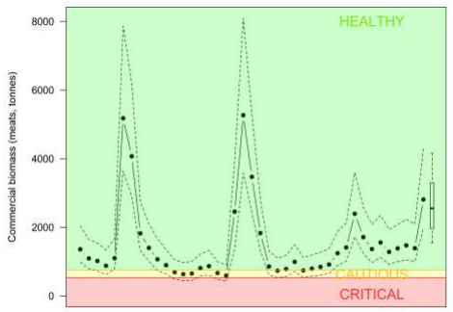
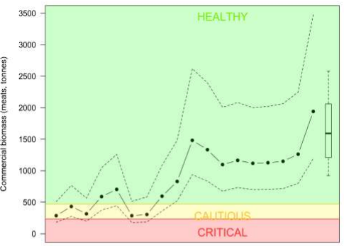
Winter Update 2023-24
Commercial Fishery Liaison Coordinator
Maliseet Nation Conservation Council
By Roger Sark
Scallop Stock Status 2023-24
Hi everyone, the following is an update on the current stock status for scallops in the Bay of Fundy, SFA 1-6.
Harvesting scallops in the Bay of Fundy includes commercial, communal commercial, and Food, Social, and Ceremonial. There are 3 commercial fleets that operate in the Bay of Fundy: Full Bay, Mid Bay, and Upper Bay fleets. The fishery is managed using limited entry, drag gear size, seasonal closures, minimum shell height, and meat counts. The Full Bay fleet operates under an Individual Transferable Quota, while the other fleets are competitive within a TAC.
The Bay of Fundy Scallop surveys are done annually by DFO. Scallop removals accounted for assessment include the commercial landings and FSC catch. Recreational landings and other FSC gear types are not recorded.
Scallop conditions in 2023 was the highest observed in the time series. The abundance was similar in all areas of SFA 1-6. Biomass increase ranged from 29% to 52%.
The Bay of Fundy scallop is in the Healthy Zone.
SFA 2 has marginal habitat and is not monitored regularly.
Page 4

Slide 4
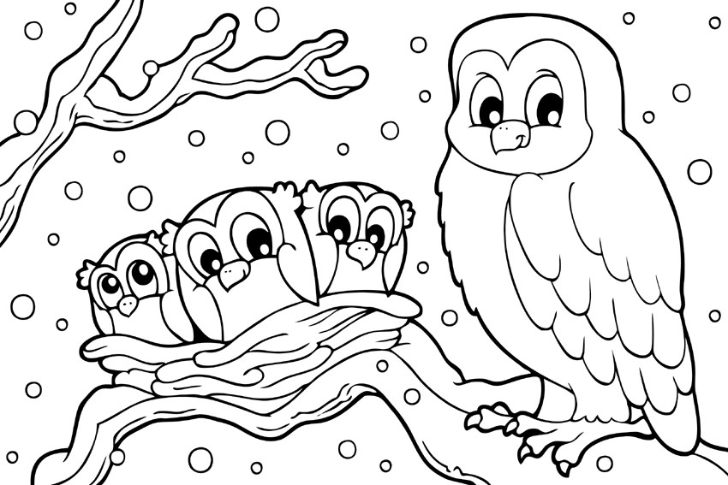
opos
tree
tihtokol owl
wast
snow
wososs
nest
pskiyatqon
branch
Merry Christmas
Woli
Nipayimiyan
cihkonaqc
turtle

